Slide 1

Ready to Rally:
Trailer Setup, Turnout Tips & Inquiry Process
Juliana Dabadie, H-B HM, C-1 DR, D-3 EV
Liberty Oaks Pony Club
Sierra Pacific Region
2026

Slide 2
Topics:
Guide to Trailer Rallies
Turnout Tips
Inquiry Process
Questions

Slide 3
Trailer Rally
A trailer rally is typically a one-day rally where horses are tied to a trailer instead of stabled in stalls or pens.
There are specific guidelines related to trailer rallies. While all rally rules apply in all stabling situations, there are some unique situations that are addressed here for trailer rallies.

Slide 4
Parking Safety
Leave space in between trailers to tie safely on both sides with room to walk down the middle
Trailers being used to tie horses must be hooked up to a towing vehicle
Set the parking brake
Wheels on the trailer must be blocked/chocked
Opinion: The best trailer to tie to AND use as a tack room at the same time is a trailer with two back doors that secure open and no ramp.
Ideally, all trailers are parked to create a “barn aisle”
Notes:
Q: “Will I get a point off for that?”
A: “That’s up to the Chief.”

Slide 5
Trailer Setup: Every Trailer is Different!
Always consult with HM to discuss the best options for safety.
Check exterior of the trailer for sharp metal and how it can be made safe
  A pool noodle will often work well for sharp metal
  Foam core board and duct tape can be used for covering license plates
  Duct tape, rags, and diapers
Doors should be secured open if used as a tack room, ramps up and doors secured if used for tying mounts. If you have a tack room AND a ramp, consult HM.
Manure forks, buckets and other bulky items not needed in the tack room can be stored between the front of the trailer and end of the truck
  This allows easy access and is out of the way of horses stepping on them
Shade tents can be used at the front of the vehicle away from the horses

Slide 6
Tie Area Setup
When tying to a trailer, it is strongly encouraged to use a device that breaks/releases in addition to a breakaway halter.
It is common for horses to pull back and break away from a trailer.
It is easier to catch a loose horse if they are still wearing a halter!
Breakaway options (in addition to a breakaway halter): baling twine, hemp twine, plastic release clips, and slow-release tie methods are all acceptable if it makes sense for the horse.
Alternative/slow-release ties are allowed without quick release knots when used as intended for those horses who do not hard/straight tie well
Many horses are not used to being tied to a trailer for long periods in a rally setting.
Inform HM staff if a horse is not doing well tied to the trailer.
Notes:
Q: “Will I get a point off for that?”
A: “That’s up to the Chief.”

Slide 7
Water at a Trailer Rally
Consult HM staff for options on hanging water buckets.
  Many trailers do not have a good option for hanging water buckets.
It is not advised to hang a hay net, water bucket, and tie a horse to the same permanent tie ring on a trailer.
A good option is to store labeled water buckets in between the trailer and tow vehicle.
If you don’t hang buckets, you must offer water to your horse
at least once per hour

Slide 8
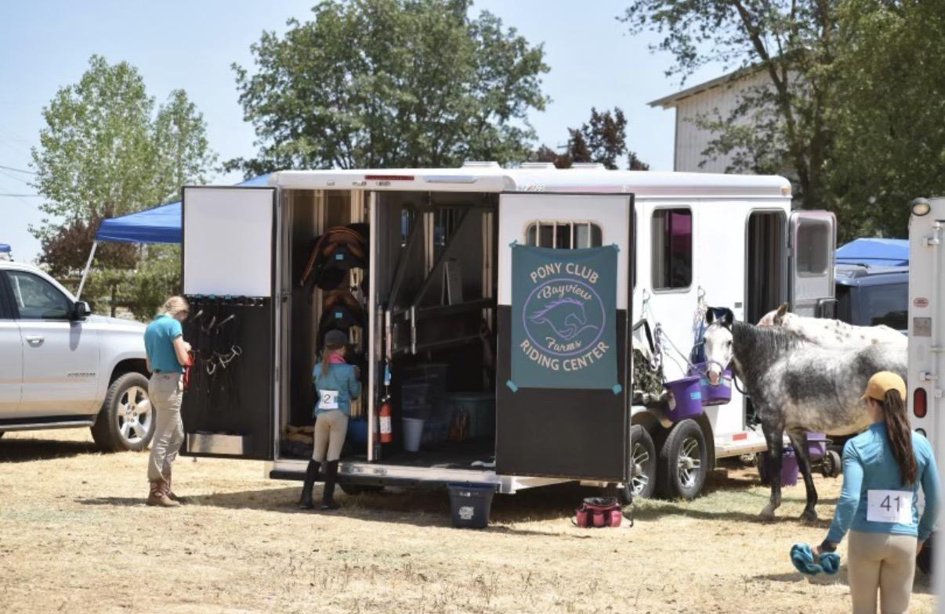
Stall Cards
The best way to secure stall cards to the trailer so it doesn’t spook mount or get damaged/removed is to tape edges with painter’s tape
Painter’s tape won’t damage paint like duct tape
Plastic sheet protectors secured with strong magnets will work on some trailers

Slide 9
Care of Mount: Trailer Rally Specifics
Pick up manure as often as possible
Mounts must be supervised at all times when tied to trailers
Have extra leads and halters ready and tagged with your contact information (this is the most likely type of rally where you will need them!)
In the event of inclement weather, be aware of the proper procedure to load and unload horses onto a trailer with the possibility of evacuation
  When loading, always wait until the tail bar is fastened before you tie
  When unloading, always untie and attach a lead before you lower the ramp, open the backdoor, or unfasten the tail bar
Consult the Safety Handbook for the Equine Safety Disaster Plan

Slide 10
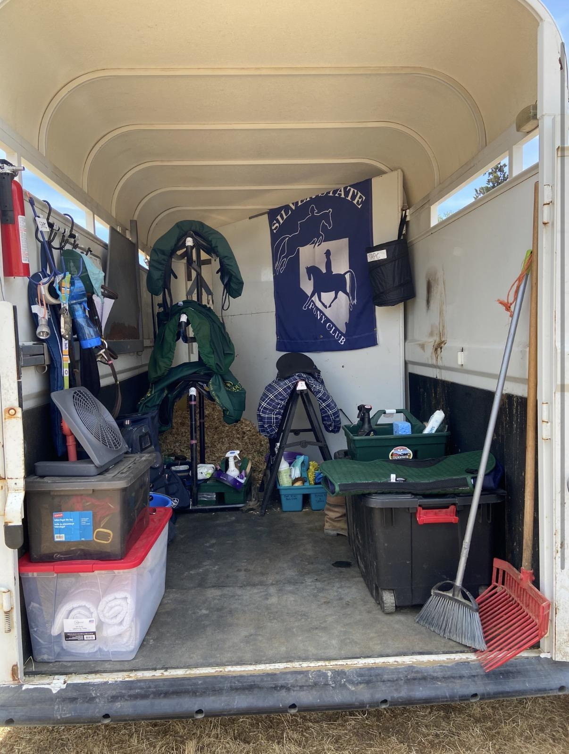
Trailer Tack Room
The trailer should be labeled "tack room" on back door
If you use the existing trailer tack room, it’s a good idea to remove any items not needed for the team
Pop-up tents/canopies can be used as tack rooms or team gathering areas.
  It provides shade and can offer more room than a trailer.
  Canopies must be set up away from mounts (at the front of the vehicle is a good option)
  Canopies must be anchored

Slide 11
Feed Rooms
The feed room may be included in the tack room
It must be visibly labeled as “feed room“ on the door
Feed charts are hung near the feed where it makes the most sense
If the trailer is entirely enclosed, it is considered to be a secure “container” for feed, so no secondary feed storage is needed
If the feed and tack room are combined, many teams choose to prepackage/pretie each feeding of hay so it can be easily stacked in a small space
Your feed chart should be written so anyone coming in could feed your horse.
Notes:
Q: “Will I get a point off for that?”
A: “That’s up to the Chief.”

Slide 12
Turnout Inspection:
How to Exceed Standards as a D
It has to be wonderful overall, not just include one of these amidst an otherwise shabby turnout for that section. These are examples from a current CHMJ, neither a complete list nor a rule:
ALL Certifications can ES if they are impressive AND:
Hairnet, Felt behind pin
D-1:
RIDER: belt, competition attire, boots clean
MOUNT: well brushed, no obvious sweat or dirt, eyes/nose/lips/dock wiped off
TACK: no jockeys or dust, properly adjusted
D-2:
RIDER: competition attire, boots clean
MOUNT: well groomed, no sweat/dirt, mane/tail brushed
TACK: bit clean, no jockeys/dust, properly adjusted, stirrup pads clean, stress points clean
D-3:
RIDER: Competition attire, boots clean
MOUNT: little dandruff, sheath/udder clean
TACK: metal polished, no cracked leather, conditioned
TIP: DO NOT leave your turnout station without discussing your turnout sheet with the judge.
Notes:
Q: “Will I get a point off for that?”
A: “That’s up to the Chief.”

Slide 13
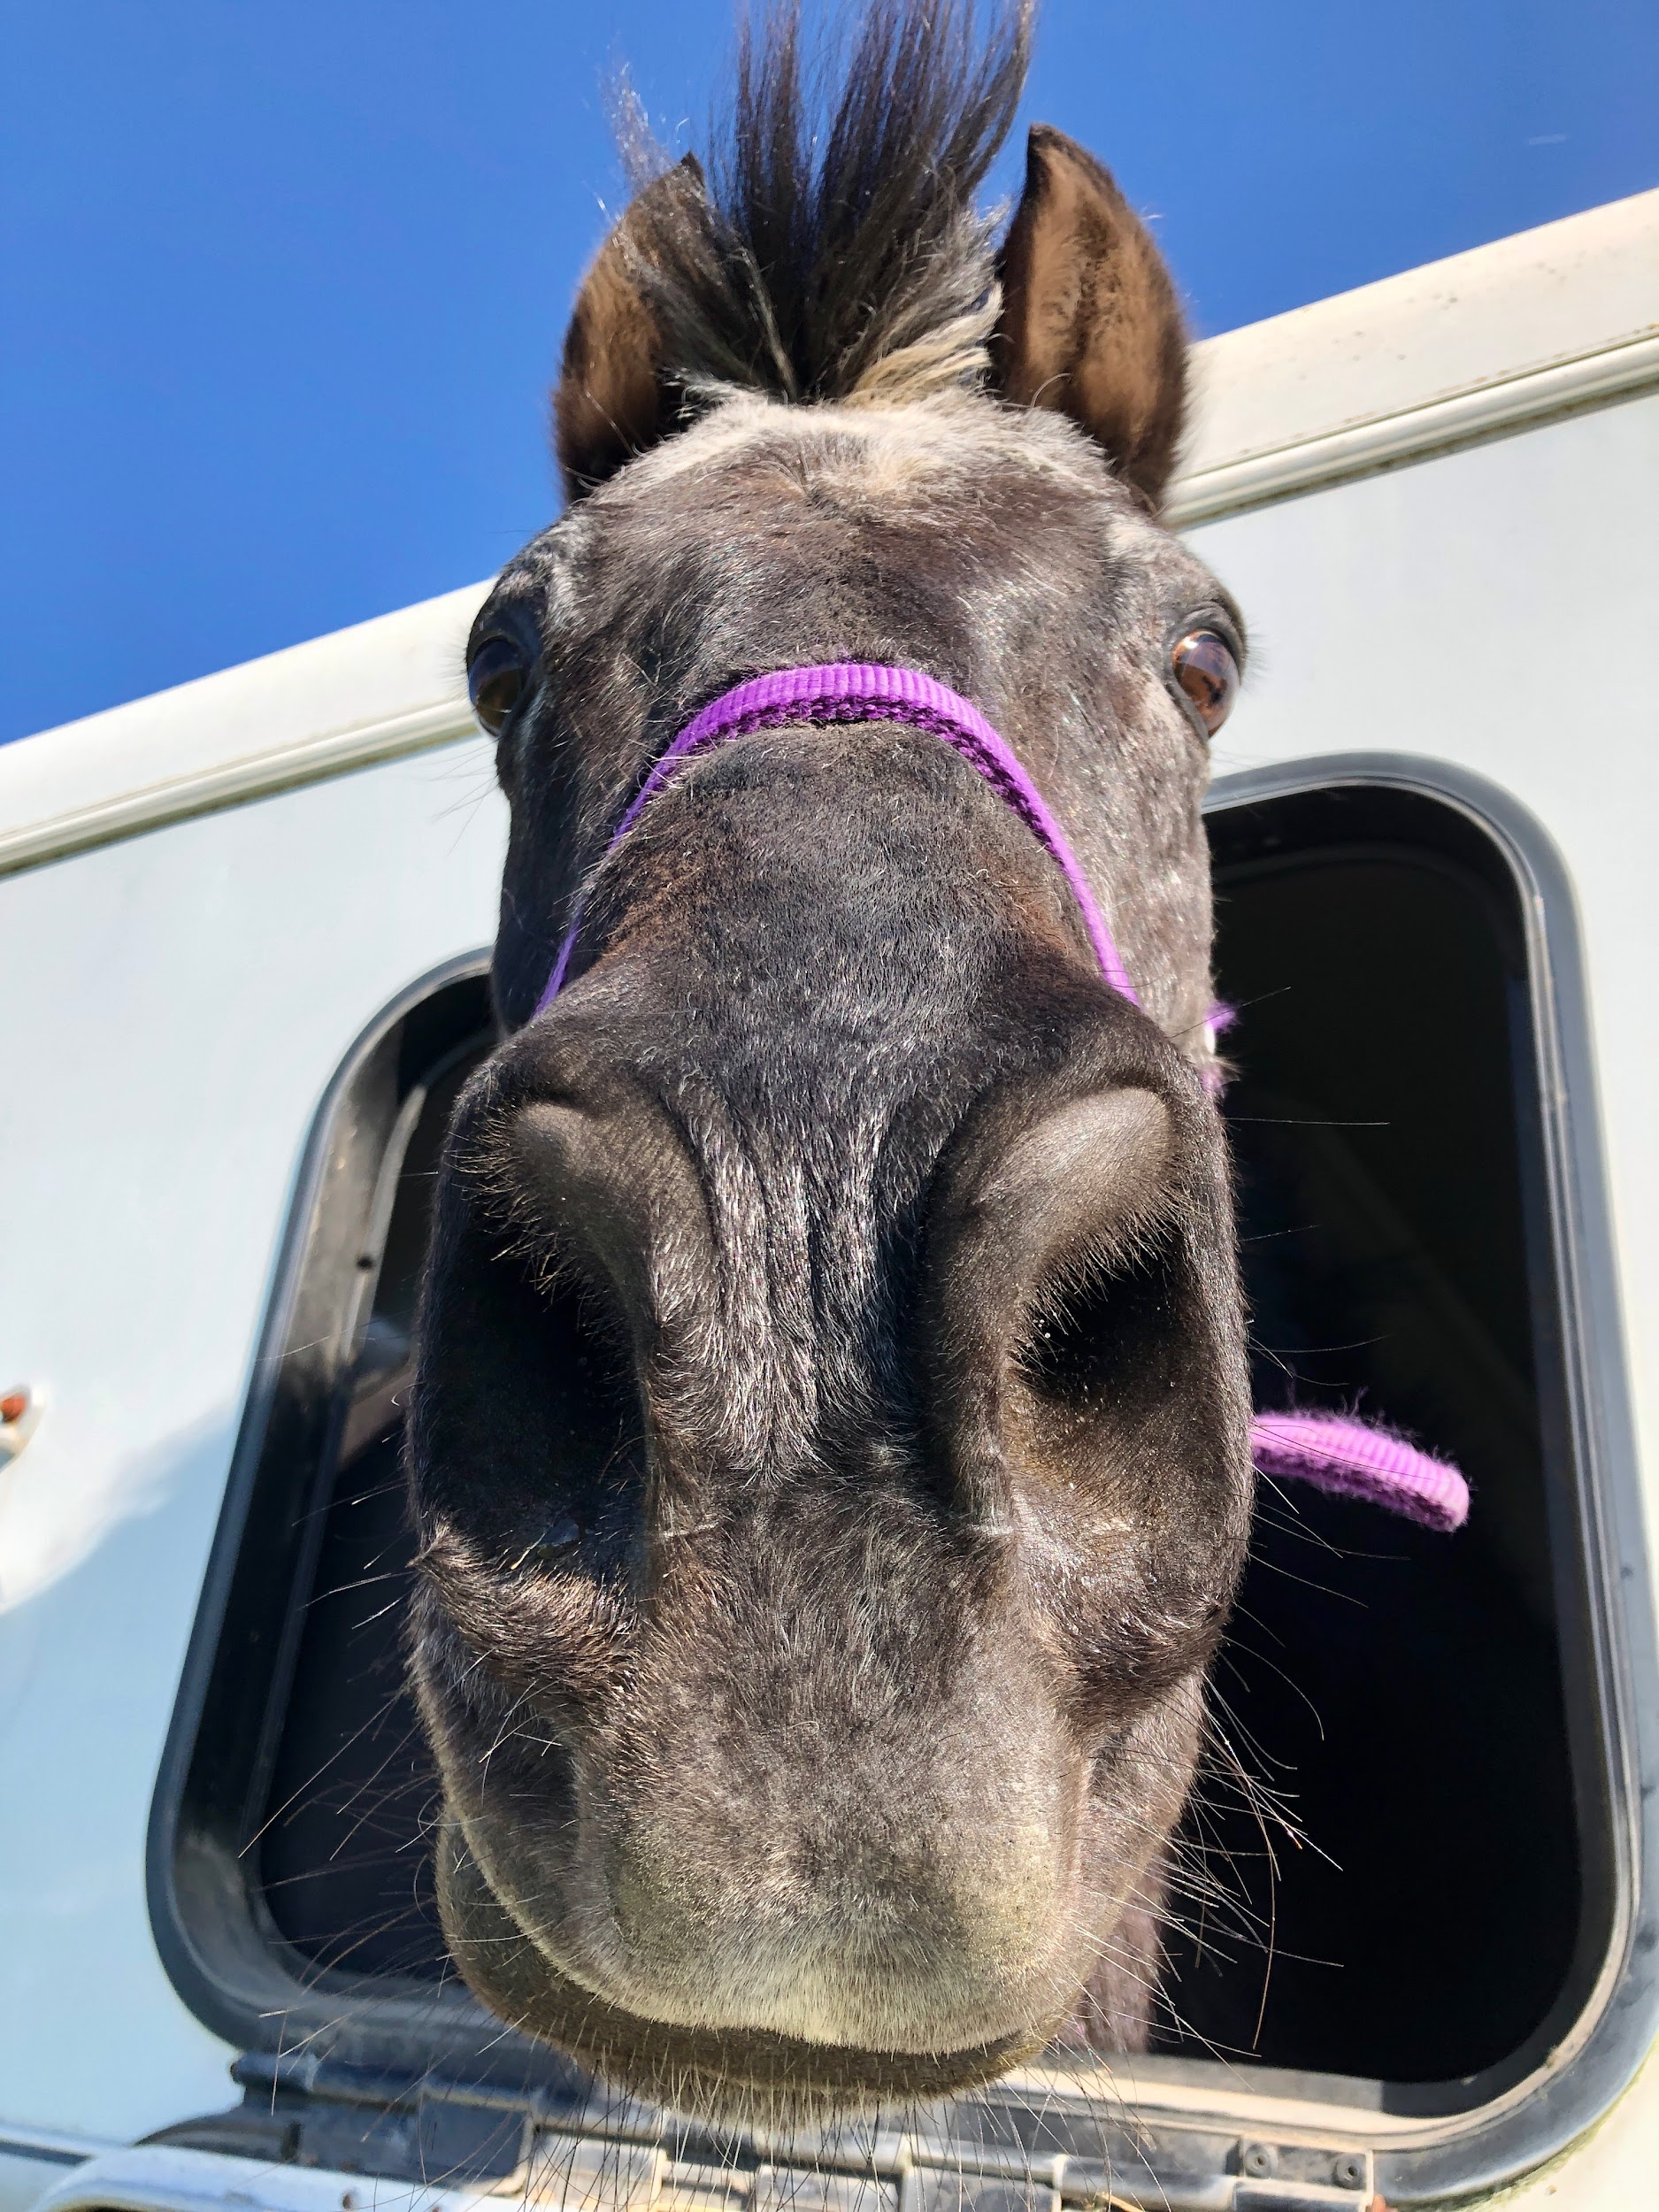
How to Exceed Standards C-A
ALL Certifications can ES if they are impressive AND:
Hairnet, Felt behind pin
C-1:
RIDER: stock tie tied properly/correct pin placement, boots polished/ in good repair
MOUNT: mane and tail clean and tangle free, no dandruff, sheath/udder showing reg attention
TACK: knowledge, maturity of discussion
C-2/H-B:
RIDER: Stock tied properly/correct pin placement through the knot
MOUNT: mane and tail clean and tangle free, no dandruff
TACK: No residue in holes or lacings, saddle pad clean and brushed
C-3/B/H-A/A:
Persistent excellence throughout
Knowledge, maturity of discussion

Slide 14
Inquiry Process for Horse Management Scores
Step 1: Verbal Inquiry
Team captain presents to CHMJ within 30 minutes of scores being posted
Inquire if you’re calm, respectful, AND:
  You don’t understand
  You disagree
  You want to learn more
You cannot get points back if you don’t inquire
Bring your rulebook open to the rule in question

Slide 15
Inquiry Process for Horse Management Scores
Step 2: Written Inquiry
Team captain present to TD (via rally office) within 30 minutes of CHMJ decision
Use official HM Written Inquiry form
You must reference the specific wording of the rule involved (why it’s helpful to be prepared at step 1)
You can be given points for a “Frivolous Protest”

Slide 16
Inquiry Process for Horse Management Scores
Step 3: Written Protest
Present same paper to the Ground Jury within 10 minutes of TD decision
This decision is final at regional rallies
Step 4: Written Appeal
Present same paper to the Championships Overall Ground Jury within 10 minutes of Discipline Ground Jury decision
Team captain and the competitor involved may accompany
This decision is final at Championships

Slide 17
Good luck at your rally!
Contact information:
Juliana Dabadie, H-B HM, C-1 DR, D-3 EV
purpledabadie@gmail.com

